Slide 1


Entertainer Details Analysis
This project aims to analyze key performance indicators (KPIs) for high-profile entertainers, providing valuable insights to help guide their career development and strategic decision-making.
By Neha Mondal

Slide 2

Key Performance Indicators
Critical Reception
Commercial Success
Reviews, awards, and industry recognition reflect an entertainer's artistic merit and impact.
Metrics like album/single sales, tour revenue, and endorsement deals showcase an entertainer's mainstream appeal and profitability.

Slide 3

About the data
Entertainer
Gender (traditional)
Birth year
Year of Breakthrough/#1 Hit/Award Nomination
Breakthrough Name
Year of First Oscar/Grammy/Emmy
Year of Last Major Work (arguable)
Year of Death

Slide 4

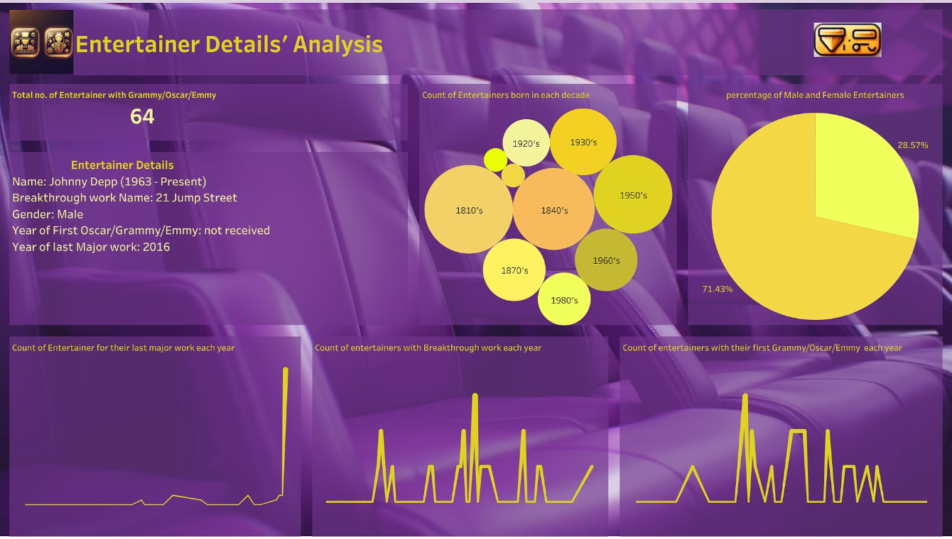

Slide 5

Analyzing the Dashboard
1
Total no. of entertainers with Grammy/Oscar/Emmy is 64. Most Grammy/Oscar/Emmy awards came in years 1962, 1964,1976, 1980, 1987.
2
Most of the entertainers are from 1810's, 1840's, 1950's. Very few entertainers are from 1890's and 1900's
3
71.5% of Entertainers are Male and 28.5% are Female.
4
Most of the entertainer had their las major work in 2016
5
1967, 1963, 1934, 1984 are the years for most of the breakthrough works.

Slide 6





Critical Reception Analysis
Awards
Reviews
Influence
Legacy
Multiple Grammy, Billboard, and other industry awards recognize the entertainer's artistic excellence and impact.
Glowing reviews from respected music critics praise the entertainer's creative vision and technical prowess.
The entertainer's work has been widely cited as inspirational and genre-defining by their peers.
The entertainer's impact and innovations have secured their place in the pantheon of history.

Slide 7




Strategic Roadmap
Maintain Artistic Integrity
Continue to prioritize creativity and critical acclaim to preserve long-term relevance.
Expand Global Reach
Strategically plan international tours and collaborations to tap into new markets.
Diversify Revenue Streams
Explore new opportunities like acting, sponsorships, and entrepreneurial ventures to sustain long-term growth.

